Slide 1
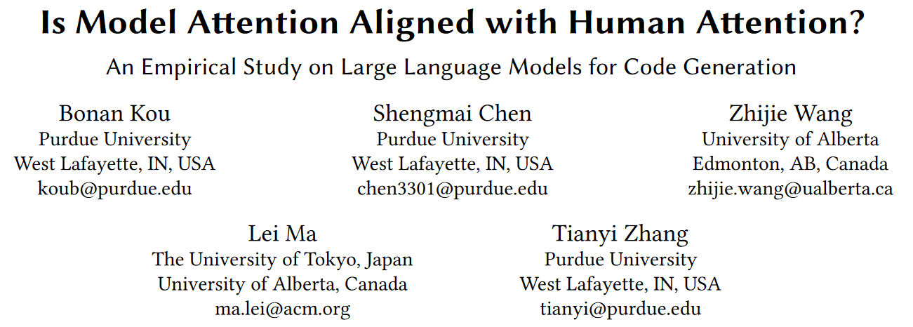
arXiv 2306.01220

Slide 2
Abstract
Background
LLMs are effective for code gen, but we don't know how they work.
Question
Do LLMs attend to the same parts of a natural language description as human programmers during code generation?
Conclusion
Consistent misalignment. Alignment and accuracy have no correlation.
Attention calculated by the perturbation-based method is most aligned with and favored by human.

Slide 3
Introduction
LLMs are effective in code gen, but we don't know how they work, because they are large and complex.
Some studies use probes or attention values to explain LLMs, but they don't analyze whether LLMs generate the code in a way similar to human. All of them also just use one explanation method. We need a comprehensive analysis of different explanation methods.
To bridge the gap, we make the first effort to analyze LLMs' attention on NL when generating code.

Slide 4
Research Questions
To what extent is model attention aligned with human attention?
Does attention misalignment lead to code generation errors?
What is the impact of attention calculation methods on alignment?
Which attention calculation method is most preferred by human?

Slide 5
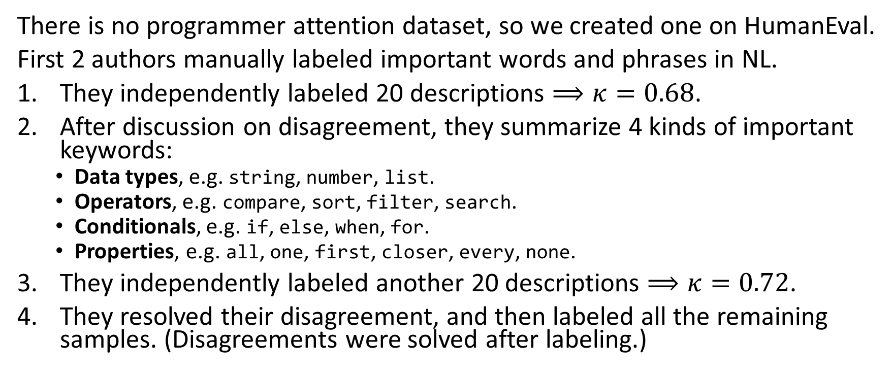
Programmer Attention Dataset
There is no programmer attention dataset, so we created one on HumanEval.
First 2 authors manually labeled important words and phrases in NL.
They independently labeled 20 descriptions $⟹κ=0.68$.
After discussion on disagreement, they summarize 4 kinds of important keywords:
Data types, e.g. string, number, list.
Operators, e.g. compare, sort, filter, search.
Conditionals, e.g. if, else, when, for.
Properties, e.g. all, one, first, closer, every, none.
They independently labeled another 20 descriptions $⟹κ=0.72$.
They resolved their disagreement, and then labeled all the remaining samples. (Disagreements were solved after labeling.)

Slide 6
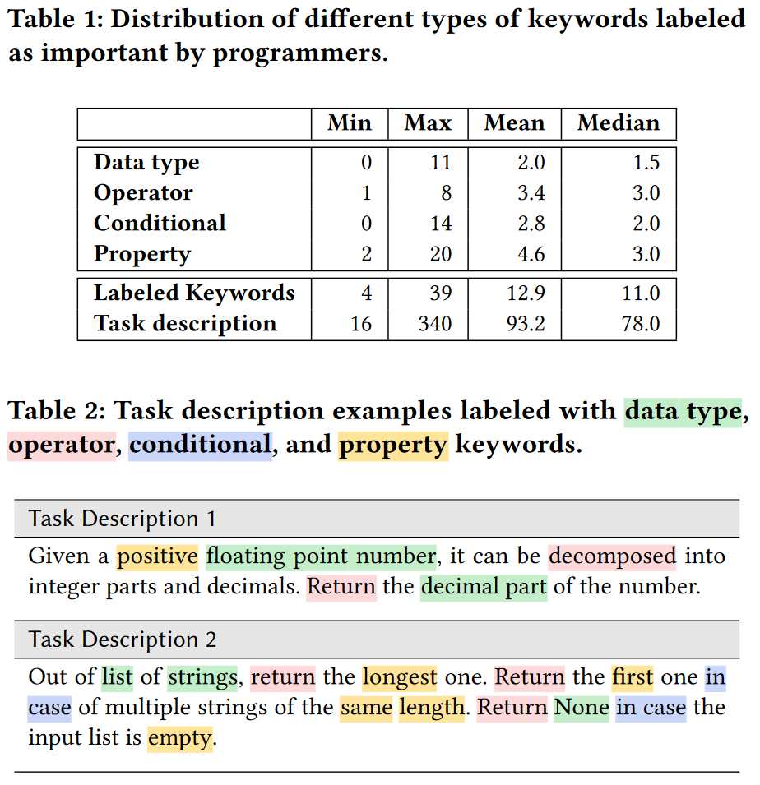
Programmer Attention Dataset

Slide 7
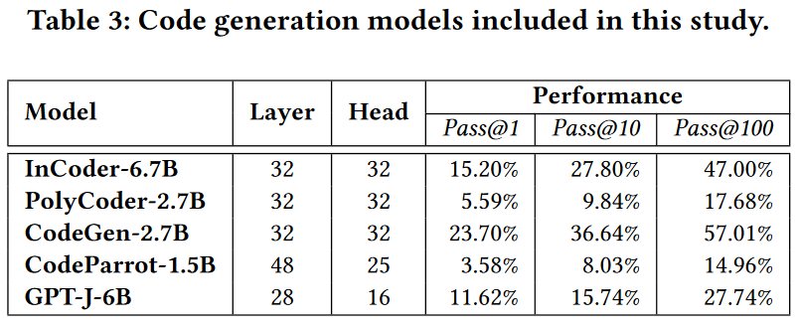
Study Design - Models

Slide 8
Methodology - Attention
In this work, attention refers to importance of NL tokens in code gen.
Self-attention-based:
Use the first/the last/all attention layer(s).
We sum up attention values from different heads (following previous work).
Sum up attention scores during the input reading process/coding process.
Perturbation-based:
SHAP: proposed in a 2017 NeurIPS paper.
BERT Masking: BLEU(LLM(NL), LLM(replace one token in NL by BERT's prediction)).

Slide 9
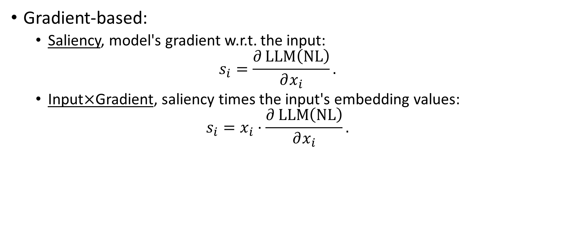
Methodology - Attention
Gradient-based:
Saliency, model's gradient w.r.t. the input:
$$s_{i}=\frac{∂\operatorname{LLM}\left(NL\right)}{∂x_{i}}.$$
Input$×$Gradient, saliency times the input's embedding values:
$$s_{i}=x_{i}⋅\frac{∂\operatorname{LLM}\left(NL\right)}{∂x_{i}}.$$

Slide 10
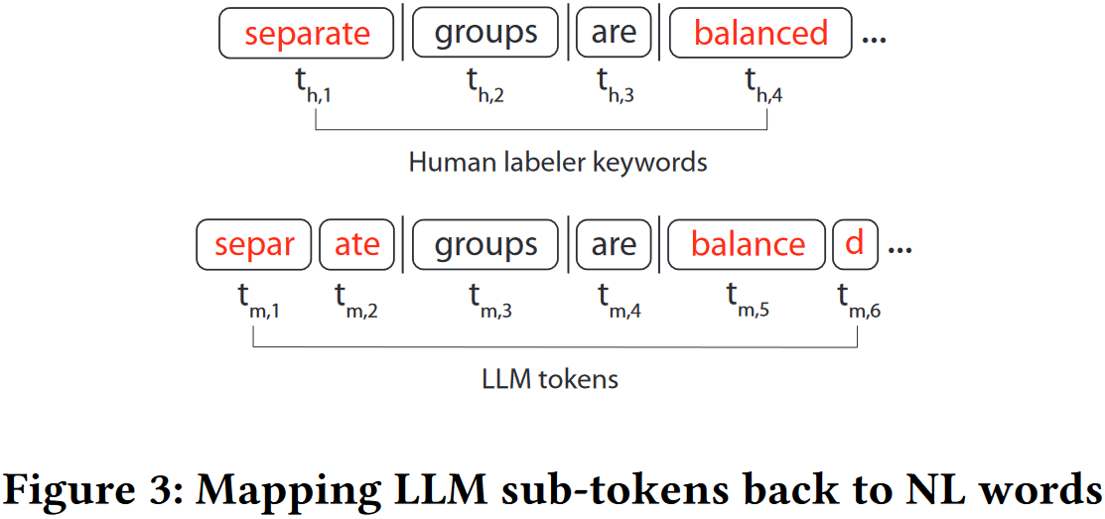
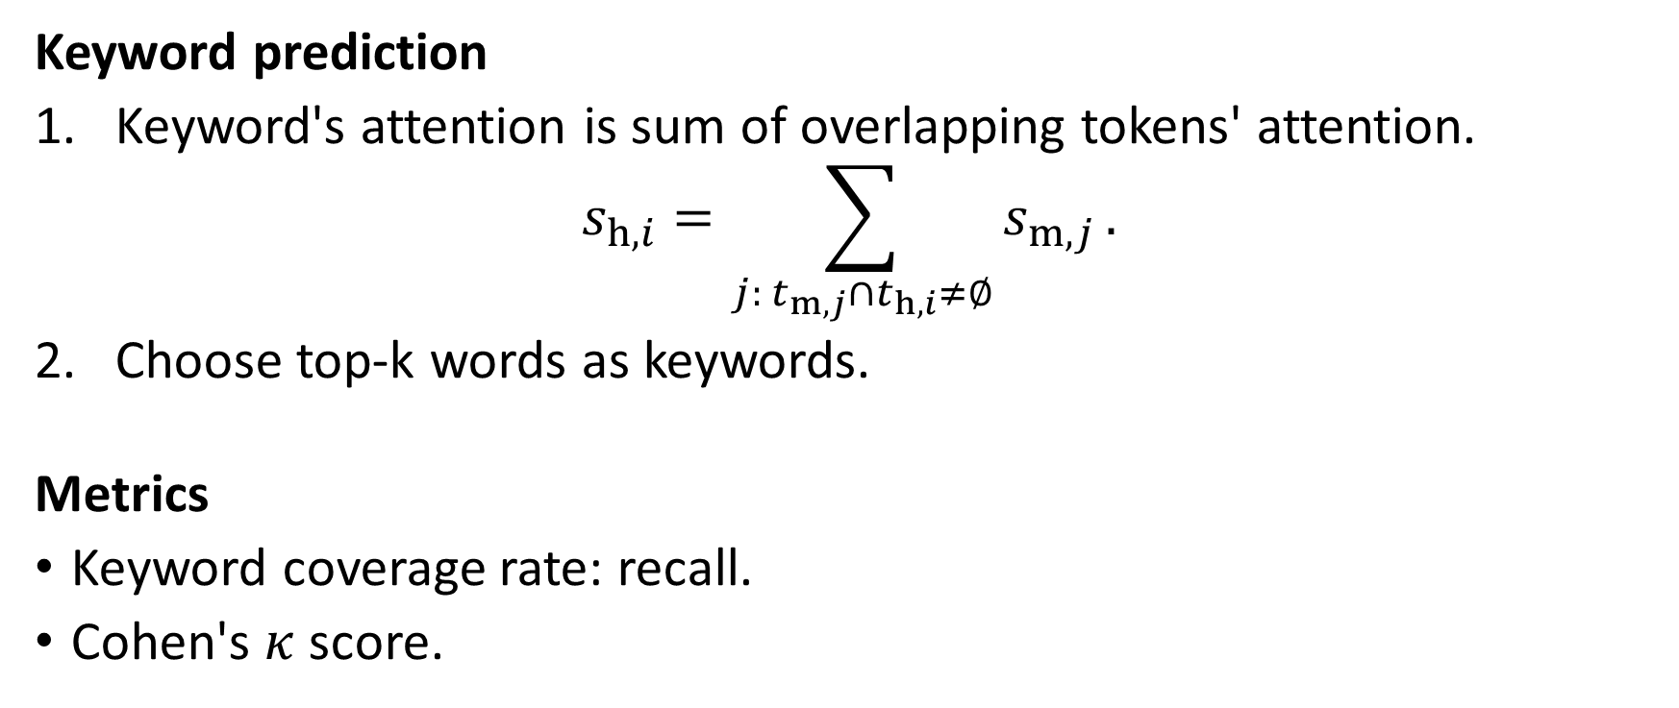
Methodology - Attention Alignment
Keyword prediction
Keyword's attention is sum of overlapping tokens' attention.
$$s_{h, i}=\sum_{j: t_{m, j}∩t_{h, i}≠∅}{s_{m, j}}.$$
Choose top-k words as keywords.
Metrics
Keyword coverage rate: recall.
Cohen's $κ$ score.

Slide 11
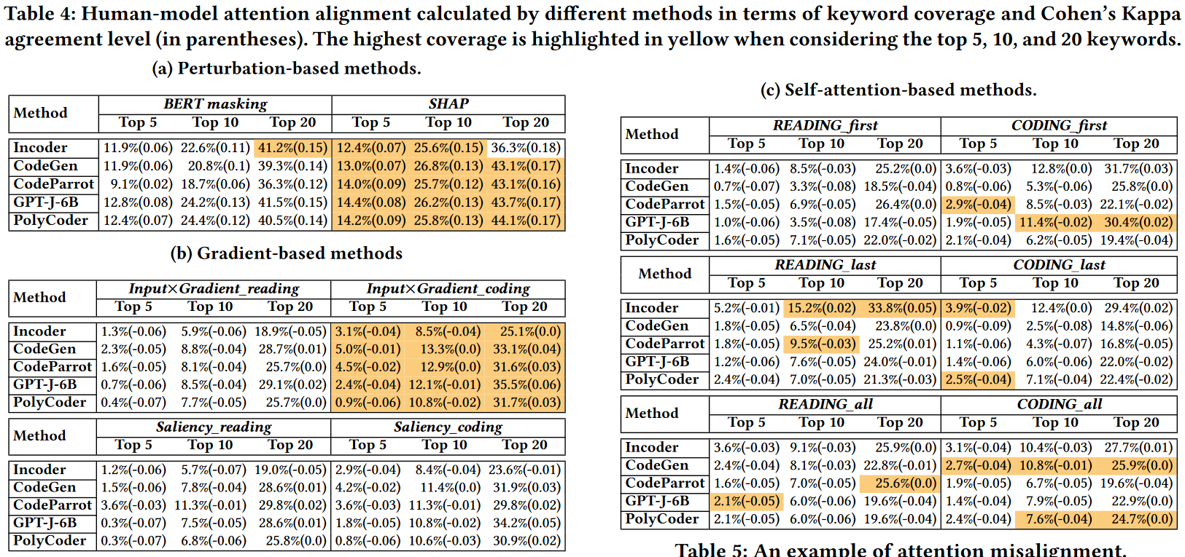
Results - RQ1
RQ1 To what extent is model attention aligned with human attention?

Slide 12
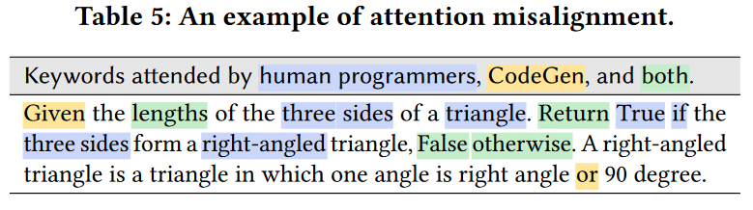

Results - RQ1
RQ1 To what extent is model attention aligned with human attention?
Finding 1 Consistently $κ<0.2 ⟹$ little or no alignment.

Slide 13
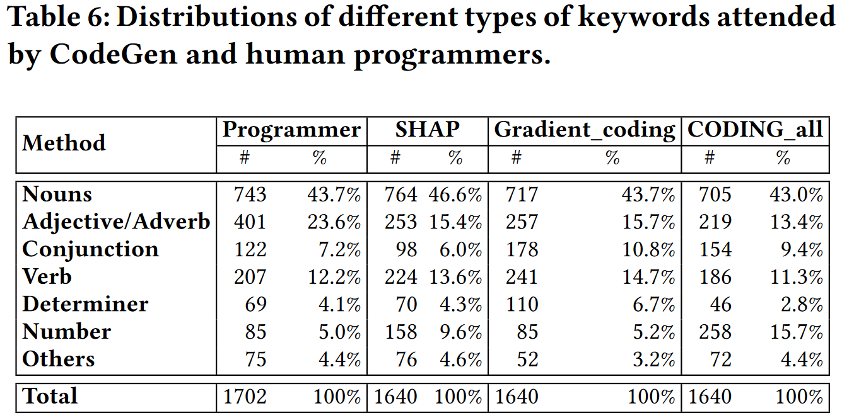
Results - RQ1
RQ1 To what extent is model attention aligned with human attention?
Finding 2 Programmers are more sensitive to adj. and numbers.

Slide 14
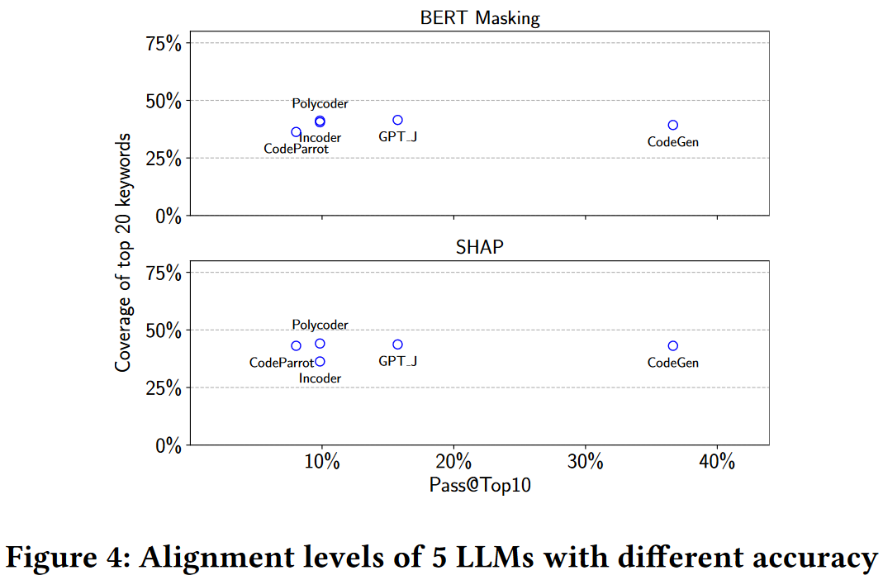
Results - RQ2
RQ2 Does attention misalignment lead to code generation errors?
Finding 3 No statistical evidence.

Slide 15
Results - RQ2
RQ2 Does attention misalignment lead to code generation errors?
Finding 4 The model attention can explain generation errors.
We conduct a case study on 20 random incorrect solutions of CodeGen.
We identify 3 common patterns:
Missing Logic(14): ignores required condition/operation/functionality.
Code Hallucination(3): generates extra code.
Code Repetition(3): unnecessarily generate repeated code.

Slide 16
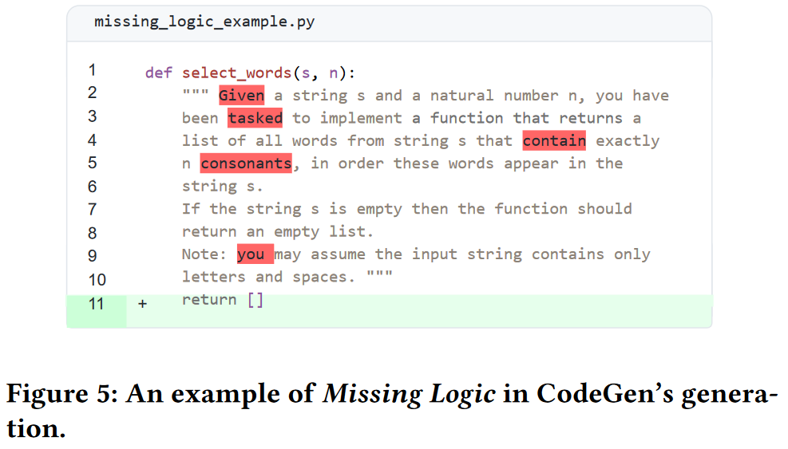
Results - RQ2
RQ2 Does attention misalignment lead to code generation errors?
Missing Logic(14): ignores required condition/operation/functionality.

Slide 17
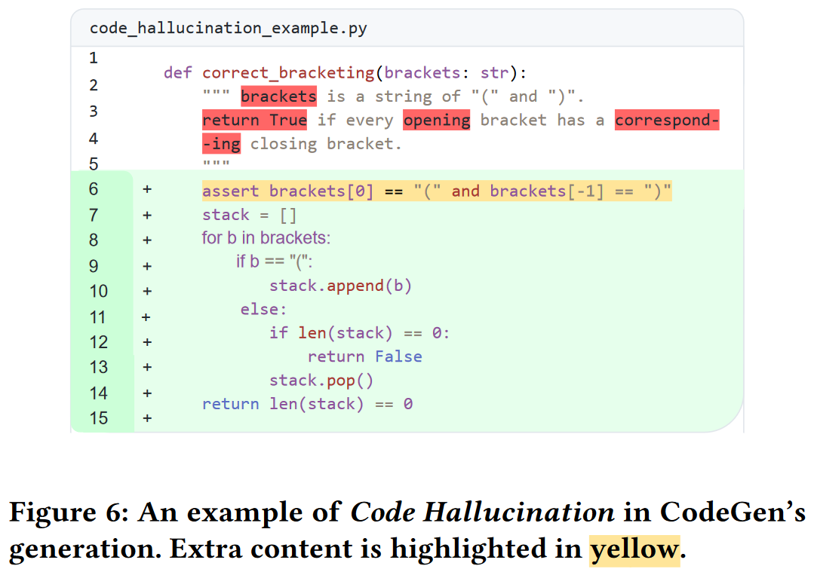
Results - RQ2
RQ2 Does attention misalignment lead to code generation errors?
Code Hallucination(3): generates extra code.

Slide 18
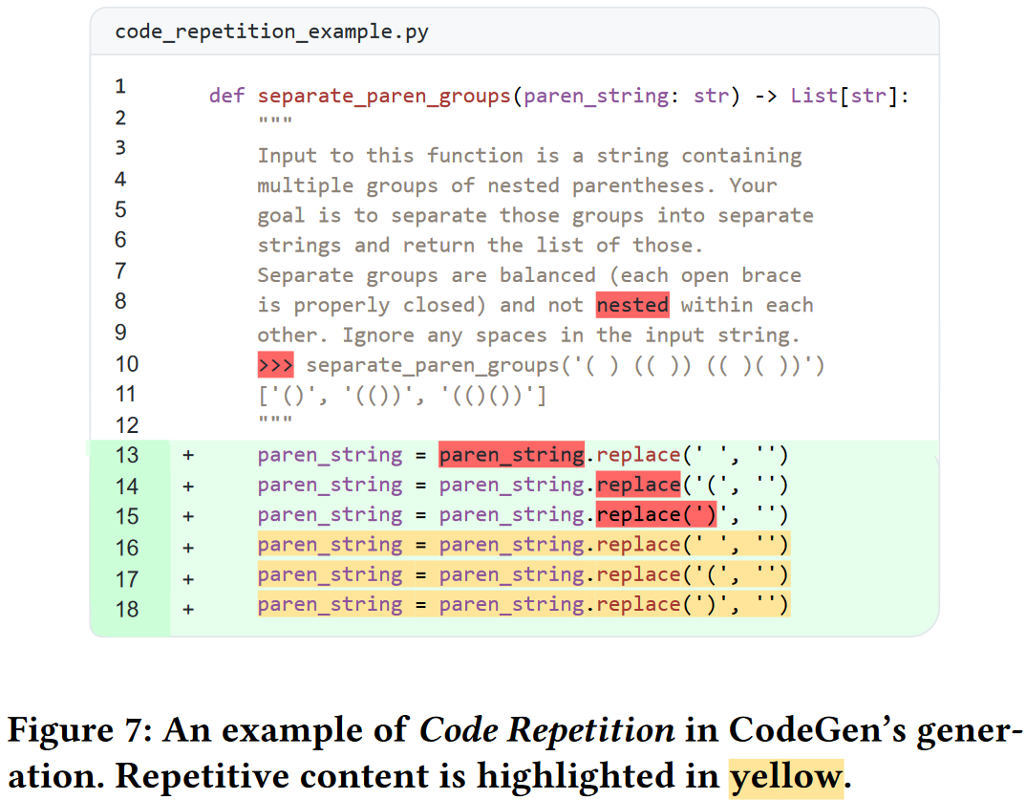
Results - RQ2
RQ2 Does attention misalignment lead to code generation errors?
Code Repetition(3): unnecessarily generate repeated code.

Slide 19

Results - RQ3
RQ3 What is impact of attention calculation methods on alignment?
Finding 5 SHAP performs the best; Input$×$Gradient coding is best in gradient-based methods; self-attention-based methods are the same.

Slide 20

Results - RQ3
RQ3 What is impact of attention calculation methods on alignment?
SHAP is sensitive to numbers; Input$×$Gradient coding and coding all pay much more attention to conj.

Slide 21
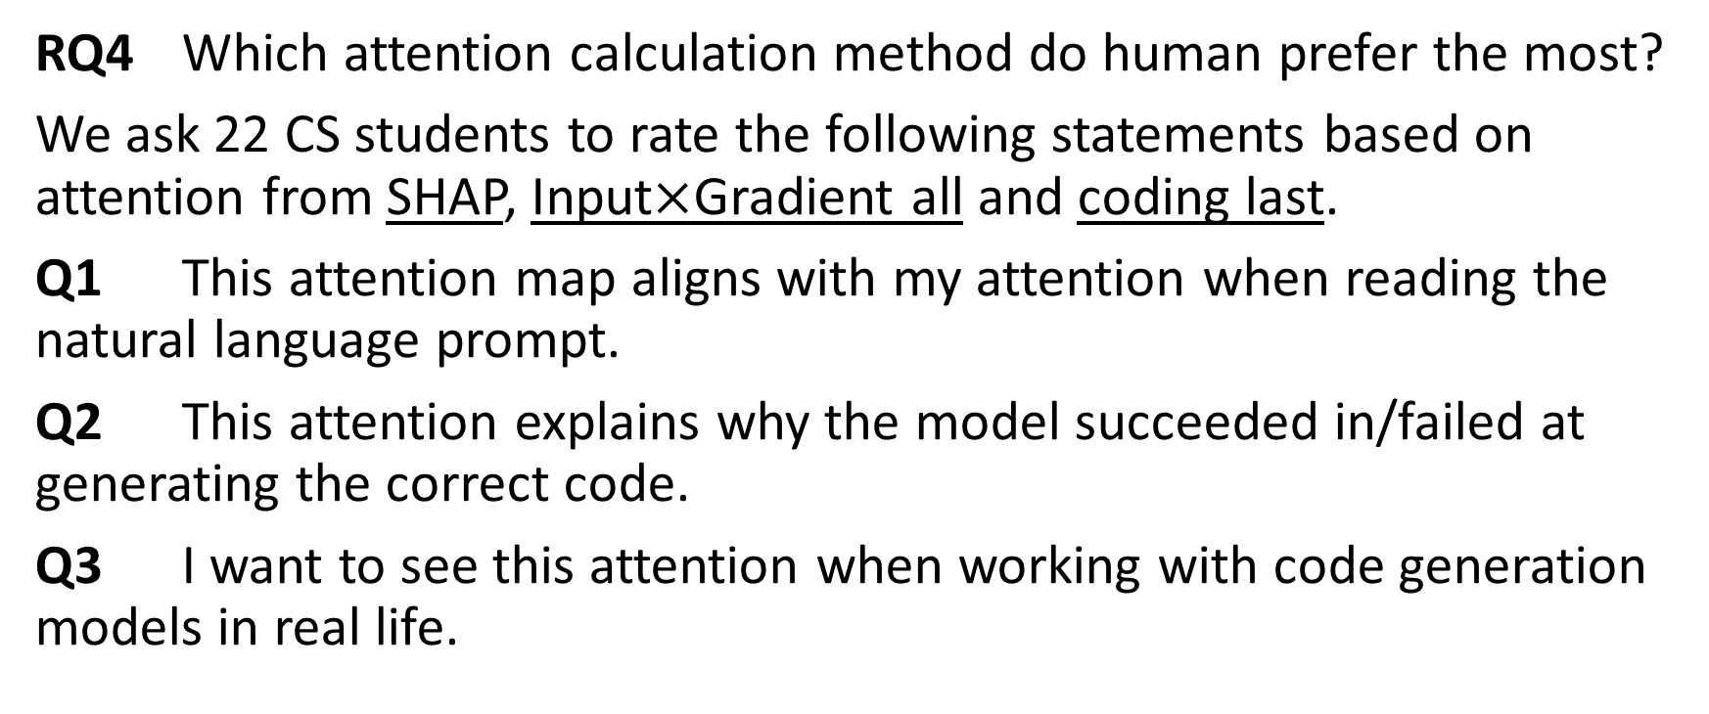
Results - RQ4
RQ4 Which attention calculation method do human prefer the most?
We ask 22 CS students to rate the following statements based on attention from SHAP, Input$×$Gradient all and coding last.
Q1 This attention map aligns with my attention when reading the natural language prompt.
Q2 This attention explains why the model succeeded in/failed at generating the correct code.
Q3 I want to see this attention when working with code generation models in real life.

Slide 22
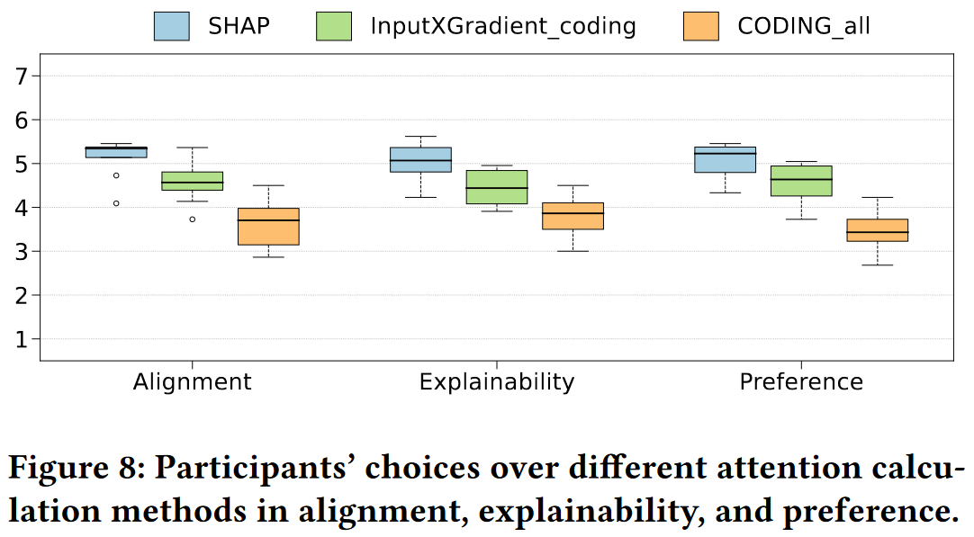
Results - RQ4
RQ4 Which attention calculation method do human prefer the most?
Finding 6 Participants prefer perturbation-based method.

Slide 23
Results - RQ4
RQ4 Which attention calculation method do human prefer the most?
Finding 6 Participants still feel a lack of trust in LLMs after seeing attention-based explanations, and wish to see richer explanations, e.g. reference code and fine-grained attention mapping between text and code.
Q4 Are you interested to know how the LLM generates the code?
Q5 What do you want to find out about the internal code generation process in LLM?
Q6 Do you trust this LLM? What do you need to know to improve the trust of the LLM?

Slide 24
Implications and Opportunities
LLMs seem to understand the task in a drastically different manner compared with human. How does it solve so many problems? Is it necessary to force them to follow human attention?
Perturbation-based methods should be considered first. But no method wins all other methods in all aspects. Test first.
Programmers' attention dataset can maybe serve as a benchmark? New ways to construct the dataset?
Fine-tune LLM to align attention with human? Stop model from erring by detecting common patterns?

Slide 25
The End. Thank you!

